Slide 1

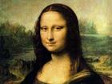
Module 2
The Renaissance

Slide 2
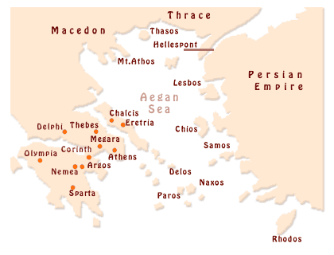
Ancient Greece

Slide 3
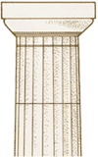
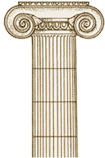
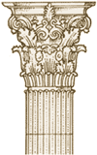
Greek Temple Architecture
The Doric
style (its top:
plain; used in
mainland
Greece and
the colonies
in southern
Italy)
The Ionic style
(thin, elegant;
top:decorated
with a scroll-
like design;
found in
eastern
Greece.
The Corinthian
style (often seen
seen on Roman
temples;
top: decorated
with leaves)

Slide 4
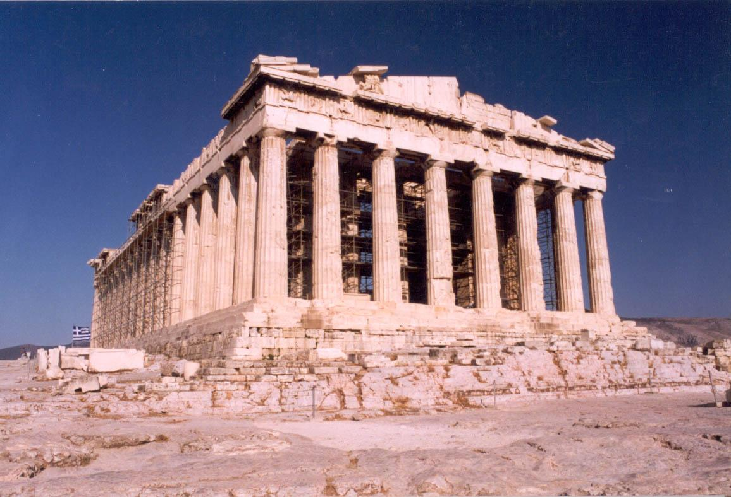
Parthenon
Built in the 5th century BC, it has sustained over the centuries despite the enormous damage, it still communicates the ideals of order and harmony for which Greek architecture is known.

Slide 5
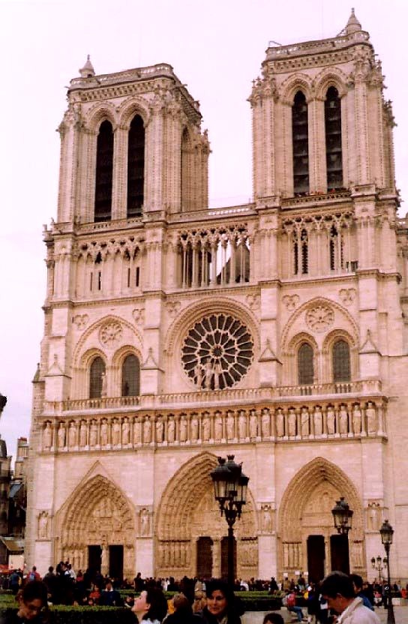
Notre Dame cathedral
巴黎圣母院（法）
（11－15世纪）哥特式

Slide 6
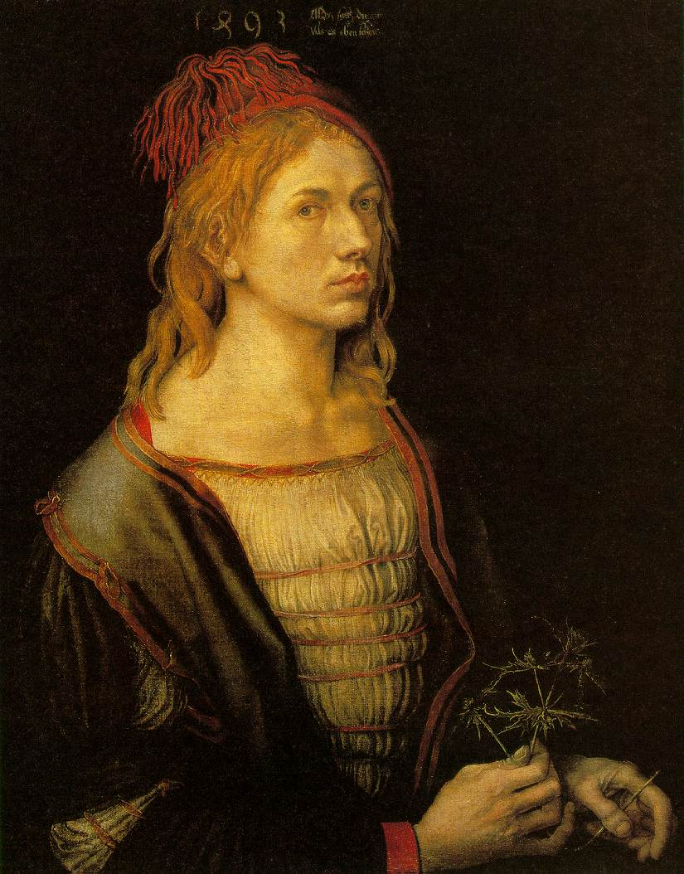
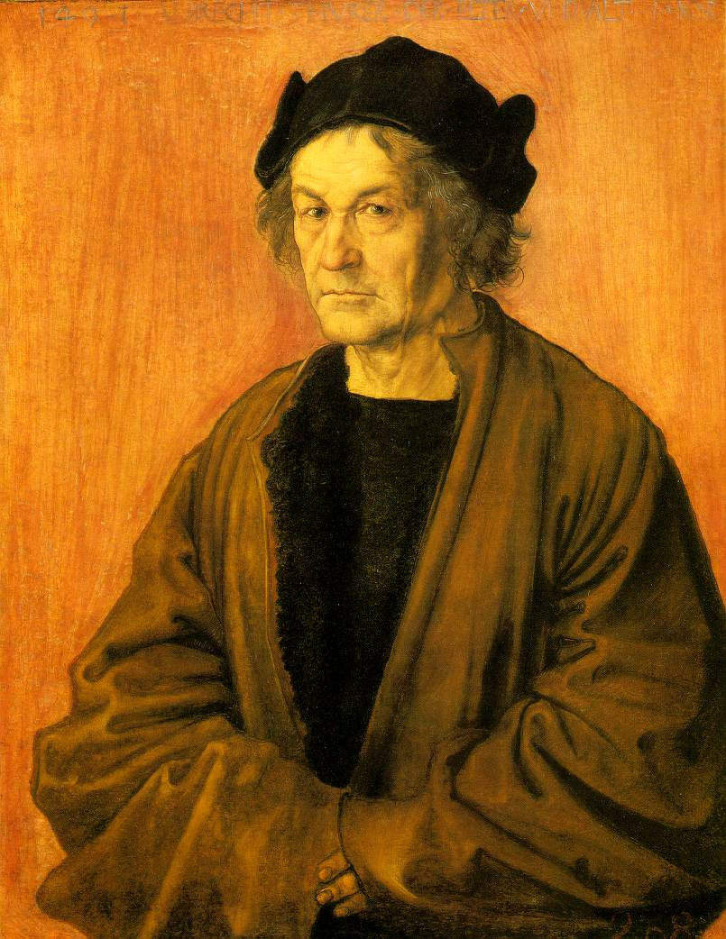
Introduction: Brainstorming
丢勒自画像
丢勒父亲像

Slide 7
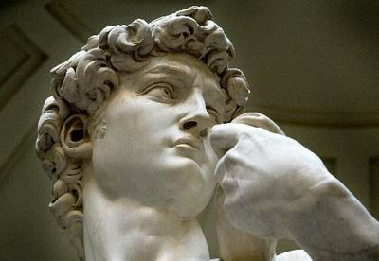
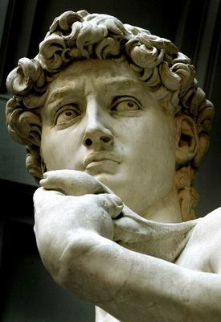
Introduction: Brainstorming
米开朗其罗的大卫雕像
Michelangelo Buonaratti’s David

Slide 8
Background: What are mentioned?
From paintings to sculptures, from novels to plays, from music to films, and the like, all are indispensable components of human's culture. Michelangelo's David gives the people courage to fight against the former influence.

Slide 9
Background: What are mentioned?
Mona Lisa's smile conquers millions of people, even nowadays, there are still myriad fans crazy about her smile. The Marriage of Figaro, composed by Mozart, even always played by the orchestra. It is hard to imagine that what will be like if we live in a society without the artist and their works.

Slide 10
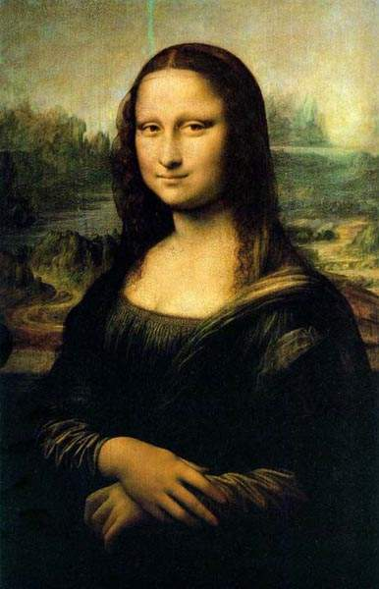
Monalisa’s Smile
蒙
娜
丽
莎
的
微
笑

Slide 11
Activity 1 on Page 15
Positive comments | Reasons
1
masterpiece
a work of genius;
astonishing
4

Slide 12
Activity 1 on Page 15
Negative comments | Reasons
mysterious; disturbing;
strangely unreal
2
too dark, too dull,
uninteresting
3

Slide 13
Activity 2 on Page 15
Words to describe your thoughts about a work of art:
astonishing
dark
disturbing
dull
masterpiece
mysterious

Slide 14
Activity 2 on Page 15
Words to describe technical aspects of a painting:
background
combination
effect
light
shade
subject

Slide 15
Activity 3 on Page 15
tips:
subject: influential; the wife of a wealthy businessman; da Vinci’s mother; da Vinci himself
wearing: be dressed in the Florentine fashion of her day; too dark; mysterious;
smile: not look directly at her mouth- cheerful; otherwise, some parts of it disappear into the background. never sure if she’s smiling or not

Slide 16
Activity 3 on Page 15
tips:
background: be seated in; mountainous landscape
effect of the light: perfect; a remarkable instance of da Vinci’s technique of soft, heavily shaded modeling

Slide 17



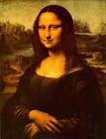
Medieval
Gothic
Classical
Renaissance

Slide 18
1.Classical (a) refers to the Middle
Ages (from about
1100 to 1500)
2.Medieval (b) refers to the period
which followed the
Middle Ages
3.Gothic (c) refer to ancient
Greece and Rome
4. Renaissance (d) refers to a typical
style of art and
architecture in the
Middle Ages

Slide 19
Reading and Vocabulary
Para. 1
Check the following sentences are facts (F) or opinions (O)
… the Mona Lisa is a mysterious masterpiece.
( )
O
What is the main idea of the first paragraph?
the introduction of the Mina Lisa

Slide 20
Para. 2
1. Questions
1) Why was the Renaissance given this name?
Because it has the concept of “rebirth”.
2) When and where did the Renaissance begin?
It took place in the 14th-16th century in Italy.

Slide 21
2. It was as if Europe was waking up after the long sleep of the Middle Ages. (facts or opinions )
_______
3. What is the main idea of the second paragraph?
the implication of the Renaissance

Slide 22
Para. 3
What does it mean that Europe was getting richer, too?
This means that people had money to spend on the arts ; and it became easier for artists to find people who could afford to buy their works or employ them.
What is the main idea of the third paragraph?
The development of trade becomes one of the factors of the Renaissance.

Slide 23
Para. 4
1. What was new about (a) painting
(b) music
(c) architecture?
(a) perspective and effects of light
(b) polyphonic music
(c) lighter building

Slide 24
2. Renaissance artists found new ideas for their work in classical Greece and Rome. (facts or opinions)
____
What is the main idea of the fourth paragraph?
They formed the new ideas on panting, music, and architecture.

Slide 25
Para. 5
How did philosophy change at this time?
People, not religion, were at the center of the universe.
What is the main idea of the fifth paragraph?
A change in ideas about religion.

Slide 26
Find out the factors that made the Renaissance possible.
1. better living conditions
2. the discovery of the new world
3. international business
4. a change in ideas about religion
5. a change in climate

Slide 27
Para. 6
The Renaissance was a time of scientific invention, too. (facts or opinions)
____
Why do people think Leonardo was an extraordinary genius as well as a great artist？
Besides being a famous painter, he was also a skilled worker inventor , who was well-known for his astonishing drawings of aeroplanes, parachutes, tanks and submarine.

Slide 28
What is the main idea of the sixth paragraph?
Something that Leonardo did as a skilled inventor.
But even if his only contribution to history had been the Mona Lisa, it would have been genius enough for all time. (facts or opinions)
_______
What is the main idea of the last paragraph?
His influence to history.

Slide 29
Activity 3
1.architecture 2. philosophy 3. contribution 4. employ 5. trade 6. art 7. literature 8. talent
Activity 4
1.mysterious 2. perspective 3. cathedral 4. motivate 5. go hand in hand

Slide 30
Form of main idea of each paragraph
Parts | Para. | topic | Main idea
Part 1
The Mona Lisa is believed to be
a masterpiece of the Renaissance.
The
Mona
Lisa
Para. 1

Slide 31
Parts | Para. | topic | Main idea
Part 2
How did the Renaissance got its name?
What’s the factor that made the Renaissance possible?
Name
and
factor 1
Para.
2
International trade is one of the factors that made the Renaissance possible.
Para.
3
Factor
2

Slide 32
Parts | Para. | topic | Main idea
Part 3 | Para. 4 |  | Renaissance artists ______________________________.
 | Para. 5 |  | Philosophers began to ____________________________.
Art
opened new frontiers
in the arts.
Philoso-
phy
change their attitudes
to God.

Slide 33
Parts | Para. | topic | Main idea
Part 3 | Para 6 |  | It was also a period of _________________and Leonardo was one of ___________________________ of that period.
 | Para 7 |  | He was ____________ ___________________of all time.
scientific invention
Science
the most famous
scientists
an
extraordinary genius
Leonar-do

Slide 34
A summary of the text:
Main idea | Give the readers a short introduction to the Renaissance and the effects caused by it.

Slide 35
Writing techniques | The passage is indeed a description with very little difficult words and expressions, so it is easy to understand. The passage begins with the example of the Mona Lisa and ends up with a short summary of its painter, Leonardo, so the passage is carefully designed.

Slide 36
Writing purpose | Tell us what the Renaissance is. Make the readers have a good knowledge of the Renaissance and its importance in the European history.

Slide 37
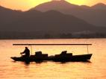
Thankyou

